Slide 1
Getting a publication for your code
Dr. Domhnall Carlin, QUB

Slide 2

Notes:
On 10 April 2019, astrophysicists announced that they had captured the first ever image of a black hole. This was exhilarating news, but none of the giddy headlines mentioned that the image would have been impossible without open-source software. The image was created using Matplotlib, a Python library for graphing data, as well as other components of the open-source Python ecosystem. Just five days later, the US National Science Foundation (NSF) rejected a grant proposal to support that ecosystem, saying that the software lacked sufficient impact.

Slide 3
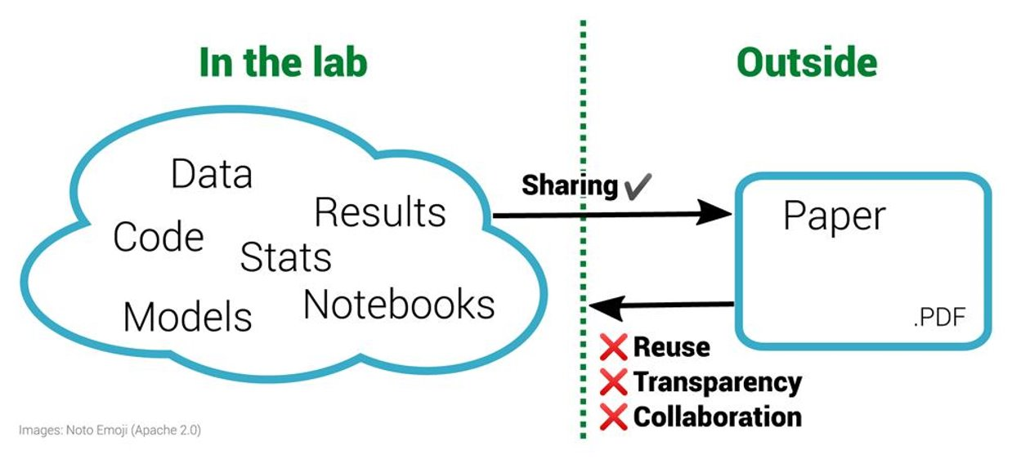
https://f1000research.com/articles/10-253/v2

Slide 4
FAIR principles
Findable
Accessible
Interoperable
Reusable.
These are aimed at research data and machines.

Slide 5
FAIR principles
What about the software that yields the results?
Software is research output, just like a paper or a monograph.
Why shouldn’t you get recognition for this work?

Slide 6
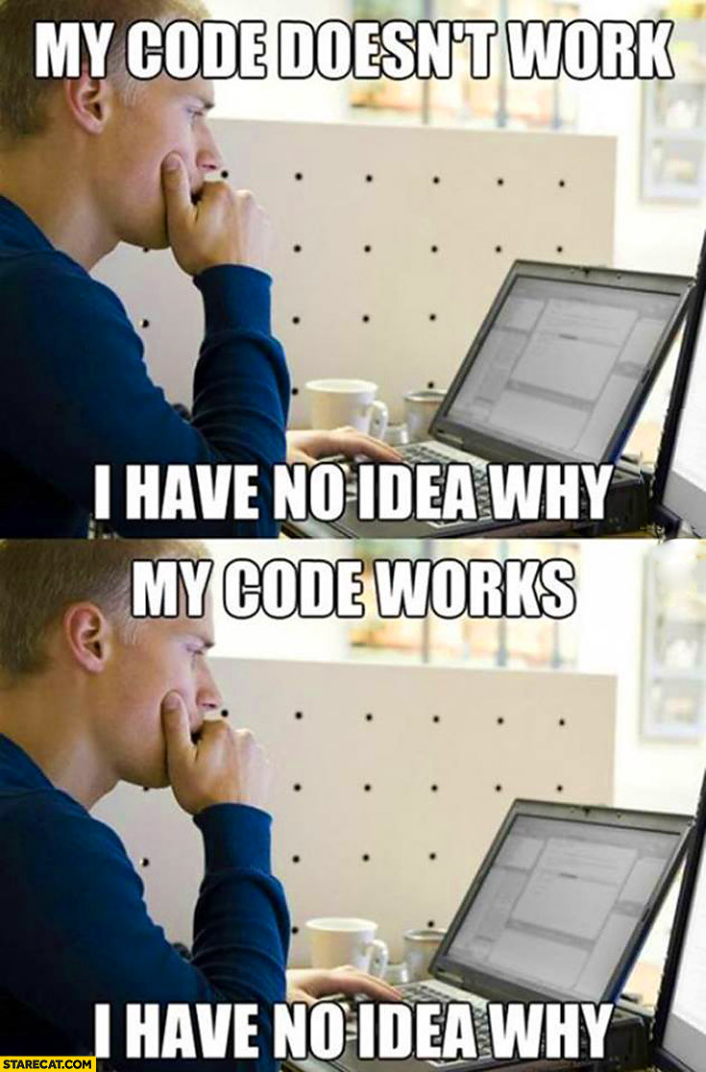

Slide 7
How to make your script ready for publication
Tobias Schlauch, Carina Haupt and the software engineering group at the German Aerospace Centre.
https://www.software.ac.uk/how-make-your-script-ready-publication

Slide 8
Step 1: Put your code under version control
Allows you to easily go back to earlier stages as well as sharing it with others.
Everything required to create a usable version of your code and to produce the intended results!
Source code,
documentation,
build scripts,
test cases,
configuration files,
input data, and other assets, but not files which can be generated by the user of the code.
IT CAN ALSO INCLUDE SECRET INFORMATION!
Notes:
Python 2 vs 3 print example

Slide 9
Step 2: Make sure that your code is in a sharable state
Cleaning up your code enables others to use it and prevents you from sharing things by accident.
Start by making your code usable and understandable.
Use common good practices recommended for your programming language and/or in your domain.
Ensure your code works not only on your machine.
Make dependencies transparent.

Slide 10
Step 3: Add essential documentation
If you want others to use or even contribute to your code, you need to document it.
Think about your target groups (i.e. user and developer)
Write down what they need to know.
Outdated documentation is the enemy, so keep it short, simple, focus on what’s essential, and, very importantly, keep the documentation close to the code.
A well written and structured README goes a long way.

Slide 11
Step 4: Add a license
Without a license, potential users can’t (re-)use your software from the legal point of view.
Go with common used and well-known licenses, so users know their rights and duties.
If you use code from others, check its license and fulfill the respective obligations.
Licenses are contracts and therefore the law applies.
This is also the case for open source licenses.
QUB policy is that when open sourcing software, it should default to GPLv3.
but, in general they like you to sign an innovation disclosure form first to see if there is any commercial potential from it prior to open sourcing.
This is not legal advice- check with your supervisor/RD/Manager

Slide 12
Step 5: Mark the stable version of your code
Releases are a great way to mark stable versions of your code which can be safely used.
They are also great to reference a version which produces a specific result.
For a release you just need two things:
First, ensure the code is stable. Tests can help you to gain confidence about the code's stability. The automatisation of tests makes release creation even easier.
Second, a release number. Common release schemes not only provide an ID, but can also provide context about the release, i.e. date of release or type of change (major, minor, bug fix). An additional changelog helps to give further context.

Slide 13
Step 6: Make your code citable
Code is often not cited today, but it is your interest to change this.
Creating and maintaining research software is academic work, and should allow for academic credit and careers.
Also citing software is an important part of the provenance of research results and enables reproducibility.
To enable your software to be cited, add the required metadata and ideally create a persistent identifier (ID) for it by utilising a service like Zenodo or Software Heritage.
Also: cite other people’s code (see biblatex-software)

Slide 14
Bare minimum
Simple README
Others will expect to find a plain-text README ³ file in any software bundle. Your deposit should conform to this expectation and provide a README file providing a summary of the key facts about your software. This should include, at the least:
Name of your software.
Brief overview of your software, what it does (for example, what research problem it was written to solve) and what makes it novel (or different or distinct from similar software already available).
Contact: Your name, affiliation, current email address and your ORCiD identifier ⁴. This provides a point of contact for others to get in touch if they have questions about your deposit and your research more generally.
Link to live software: for ongoing projects links to your project web site and/or repository hosting service. This allows others to easily find your current software from your deposit and to engage with you and your project.
Copyright and licence(s)
Authors and other contributors
https://softwaresaved.github.io/software-deposit-guidance

Slide 15
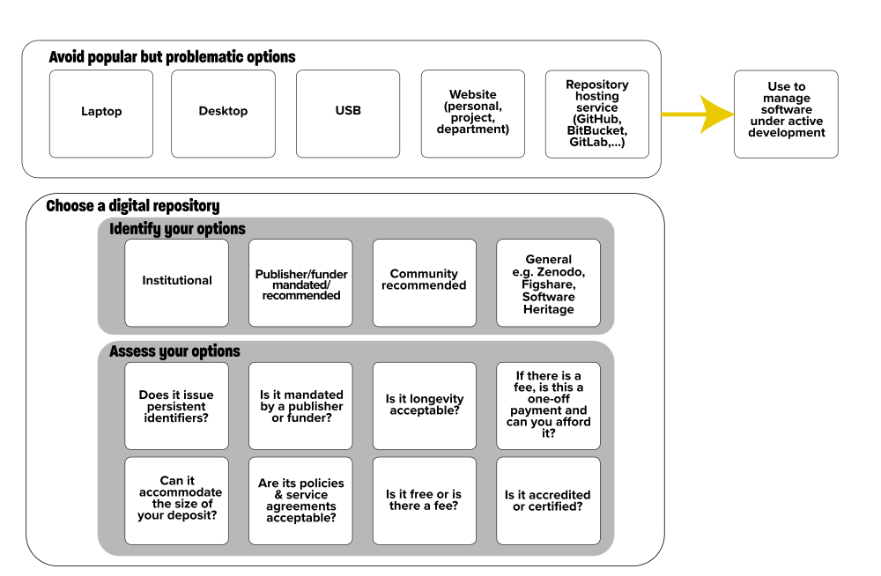
Where to deposit your research software?
https://doi.org/10.5281/zenodo.1327329
Notes:
Where not to do it (next slide)

Slide 16
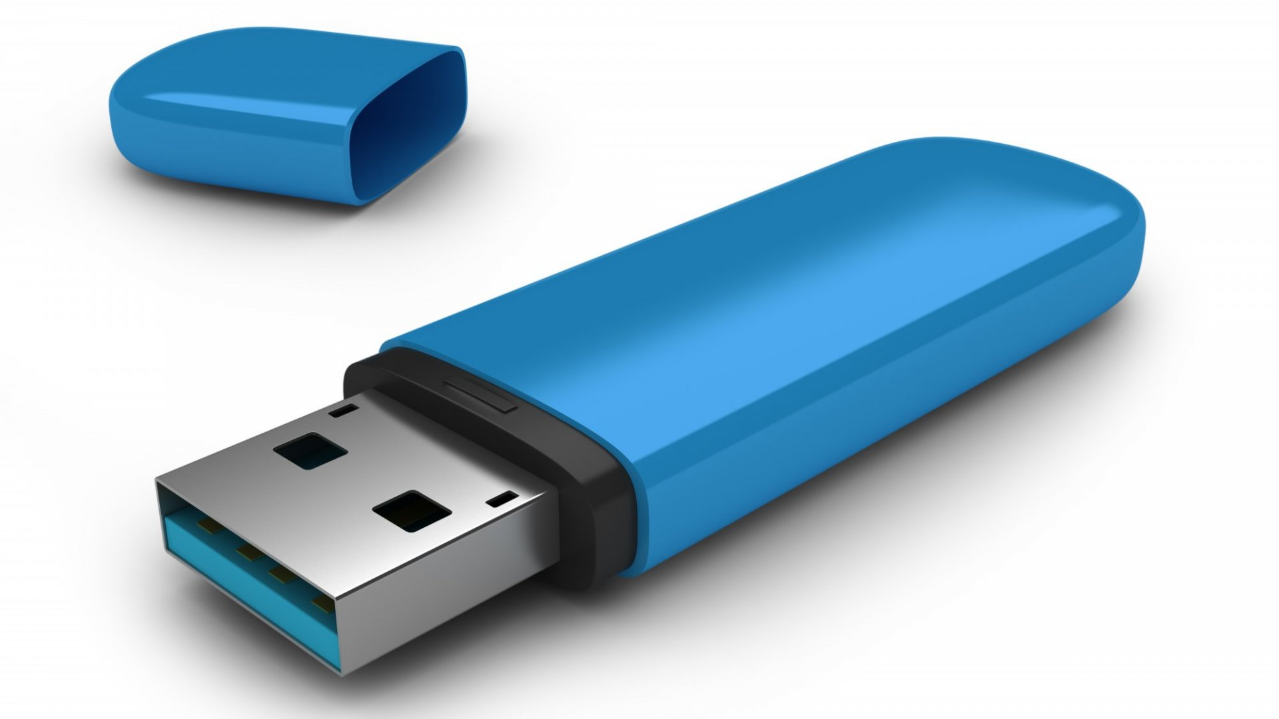


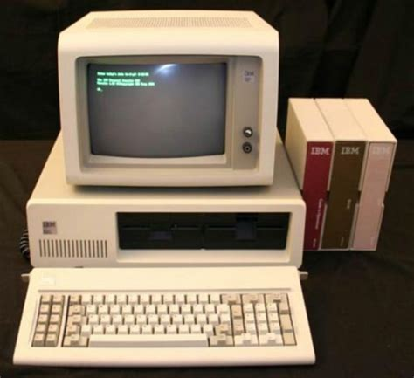


Slide 17
Zenodo
Why use Zenodo?
Safe — your research is stored safely for the future in CERN’s Data Centre for as long as CERN exists.
Trusted — built and operated by CERN and OpenAIRE to ensure that everyone can join in Open Science.
Citeable — every upload is assigned a Digital Object Identifier (DOI), to make them citable and trackable.
No waiting time — Uploads are made available online as soon as you hit publish, and your DOI is registered within seconds.
Open or closed — Share e.g. anonymized clinical trial data with only medical professionals via our restricted access mode.
Versioning — Easily update your dataset with our versioning feature.
GitHub integration — Easily preserve your GitHub repository in Zenodo.
Usage statistics — All uploads display standards compliant usage statistics

Slide 18
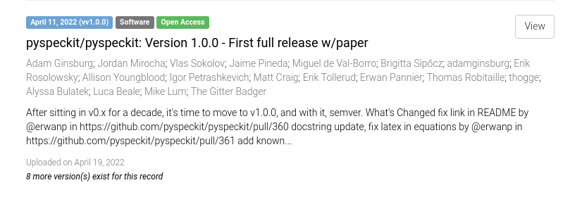
https://zenodo.org/record/6470904
Notes:
CLICK LINK TO EXPLORE

Slide 19
Software Heritage
Software Heritage allows to archive seamlessly your research software artifacts, and also to add to your research articles precise references to specific versions of the source code, down to fragments of individual source files.

Slide 20
The Journal of Open Research Software (JORS)
The Journal of Open Research Software (JORS) features peer reviewed Software Metapapers describing research software with high reuse potential. We are working with a number of specialist and institutional repositories to ensure that the associated software is professionally archived, preserved, and is openly available. Equally importantly, the software and the papers will be citable, and reuse will be tracked.
JORS also publishes full-length research papers that cover different aspects of creating, maintaining and evaluating open source research software. The aim of the section is to promote the dissemination of best practice and experience related to the development and maintenance of reusable, sustainable research software.

Slide 21
SoftwareX
To this end, SoftwareX aims to support publication of research software in such a way that:
The software is given a stamp of scientific relevance, and provided with a peer-reviewed recognition of scientific impact;
The software developers are given the credits they deserve;
The software is citable, allowing traditional metrics of scientific excellence to apply;
The academic career paths of software developers are supported rather than hindered;
The software is publicly available for inspection, validation, and re-use.
Notes:
The Impact Factor of this journal is 1.959, ranking it 56 out of 108 in Computer Science, Software Engineering
With this journal indexed in 4 international databases, your published article can be read and cited by researchers worldwide

Slide 22
Others
Journal of Software: Practice & Experience (Impact factor:2.028)
Nature Toolbox
Journal of Open Source Software
https://www.software.ac.uk/which-journals-should-i-publish-my-software
Notes:
JOSS Example https://joss.theoj.org/papers/10.21105/joss.00012

Slide 23
Questions to ask
Does the digital repository give you a unique persistent digital identifier for your deposit?
Can the digital repository accommodate the size of your deposit?
Has your funder or publisher recommended or mandated a digital repository to use?
Are the policies of the digital repository acceptable to you?
Is the longevity of the digital repository acceptable to you?
Is the digital repository free or do you have to pay a fee?
If there is a fee, is this a one-off payment and can you afford it?
Is the digital repository accredited or certified?
Michael Jackson (ed.) (07 August 2018). Software Deposit: Where to deposit software (Version 1.0). Zenodo. doi:10.5281/zenodo.1327329. Online: https://softwaresaved.github.io/software-deposit-guidance/WhereToDepositSoftware.html.

Slide 24
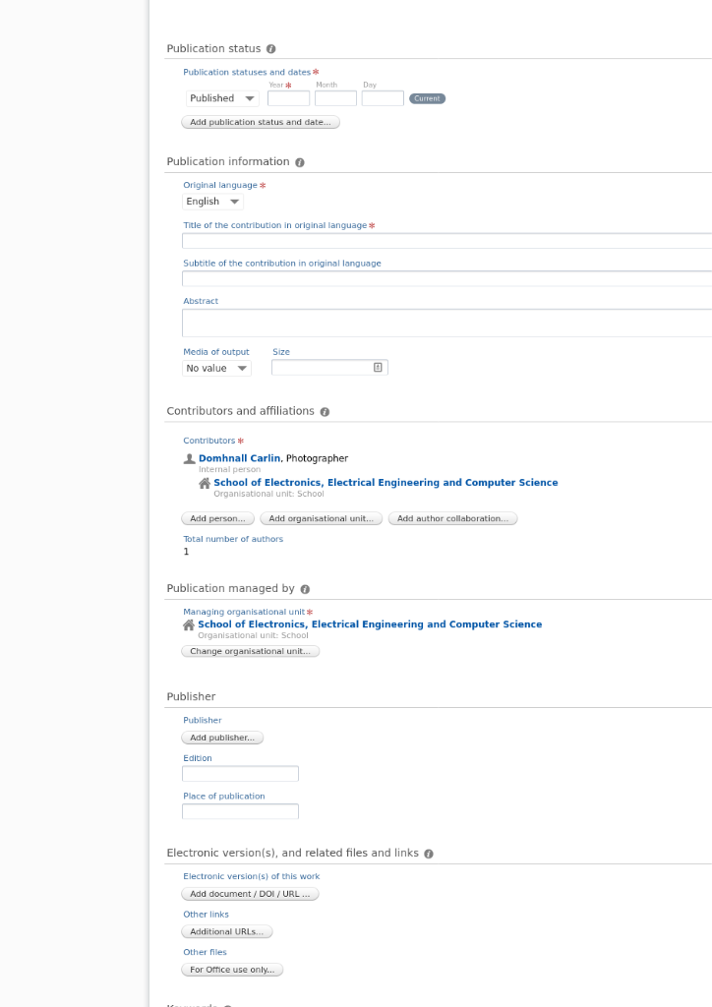

Slide 25
CFF files
https://citation-file-format.github.io/
CITATION.cff files are:
plain text files with human- and machine-readable citation information for software (and datasets).
Code developers can include them in their repositories to let others know how to correctly cite their software.
This is an example of a simple CITATION.cff file:

Slide 26
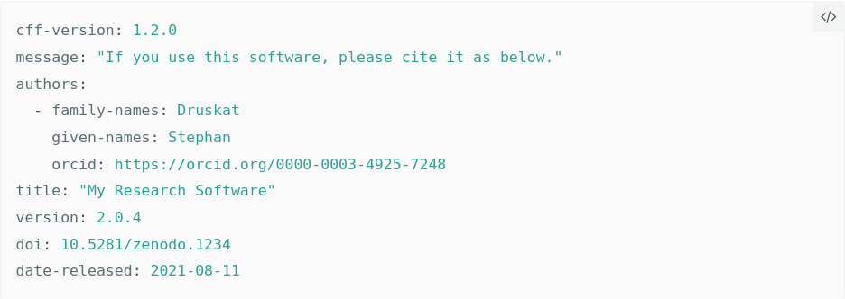

Slide 27
Why you should add a CITATION.cff file to your repository!
It is very easy to correctly cite a paper.
Software and datasets have no title page, the metadata is often less obvious.
Notes:
It is very easy to correctly cite a paper: all the necessary information (metadata) can be found on the title page or the article website.

Slide 28



Why you should add a CITATION.cff file to your repository!
People who want to cite your software may ask questions like:
What is the name of the software (it’s probably not analysis.py)?
What label should I use to uniquely identify the version of the software I have used?
What is the appropriate set of people that should be cited as authors?
Give them all the right information in a CITATION.cff file, and they can cite your software correctly.
Notes:
The person who wants to cite your software will probably not be able to answer these questions accurately and consistently themselves, but you can!
Also, if you publish your software in an archive or registry, they (or their systems) can re-use the citation metadata from your CITATION.cff file.

Slide 29
Exercise 15

Slide 30
Toolchest
https://www.software.ac.uk/which-journals-should-i-publish-my-software
biblatex-software, a bibliographic style that makes full use of SWHIDs https://www.ctan.org/tex-archive/macros/latex/contrib/biblatex-contrib/biblatex-software
https://www.software.ac.uk/REF2021guidance

